Slide 1
Behavioral Design Patterns

Slide 2
A behavioral design pattern is concerned with communication between objects and how responsibilities are assigned between objects.
Chain of Responsibility: A method for commands to be delegated to a chain of processing objects.
Command: Encapsulates a command request in an object.
Interpreter: Supports the use of language elements within an application.
Iterator: Supports iterative (sequential) access to collection elements.
Mediator: Articulates simple communication between classes.
Memento: A process to save and restore the internal/original state of an object.
Observer: Defines how to notify objects of changes to other object(s).
State: How to alter the behavior of an object when its stage changes.
Strategy: Encapsulates an algorithm inside a class.
Visitor: Defines a new operation on a class without making changes to the class.
Template Method: Defines the skeleton of an operation while allowing subclasses to refine certain steps.

Slide 3
Definition: The Observer Pattern defines a one-to-many dependency between objects so that when one object changes state, all its dependents are notified and updated automatically.
Purpose: Promotes loose coupling between the subject and observers.
Real-World Analogy: A news agency (subject) notifies subscribers (observers) when news is published.

Slide 4
The Observer Design Pattern is a behavioral pattern that defines a one-to-many dependency between objects so that when one object (the subject) changes state, all its dependents (the observers) are notified and updated automatically.
The observer pattern is also known as Dependents or Publish-Subscribe.

Slide 5
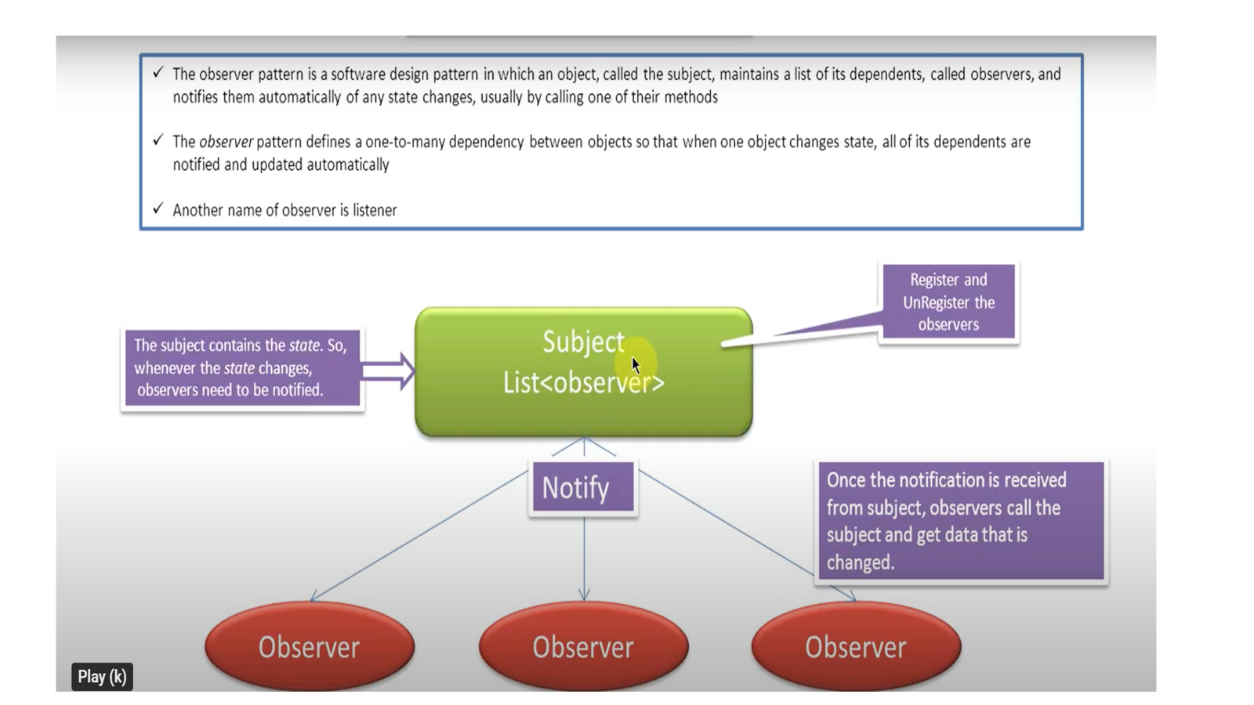

Slide 6
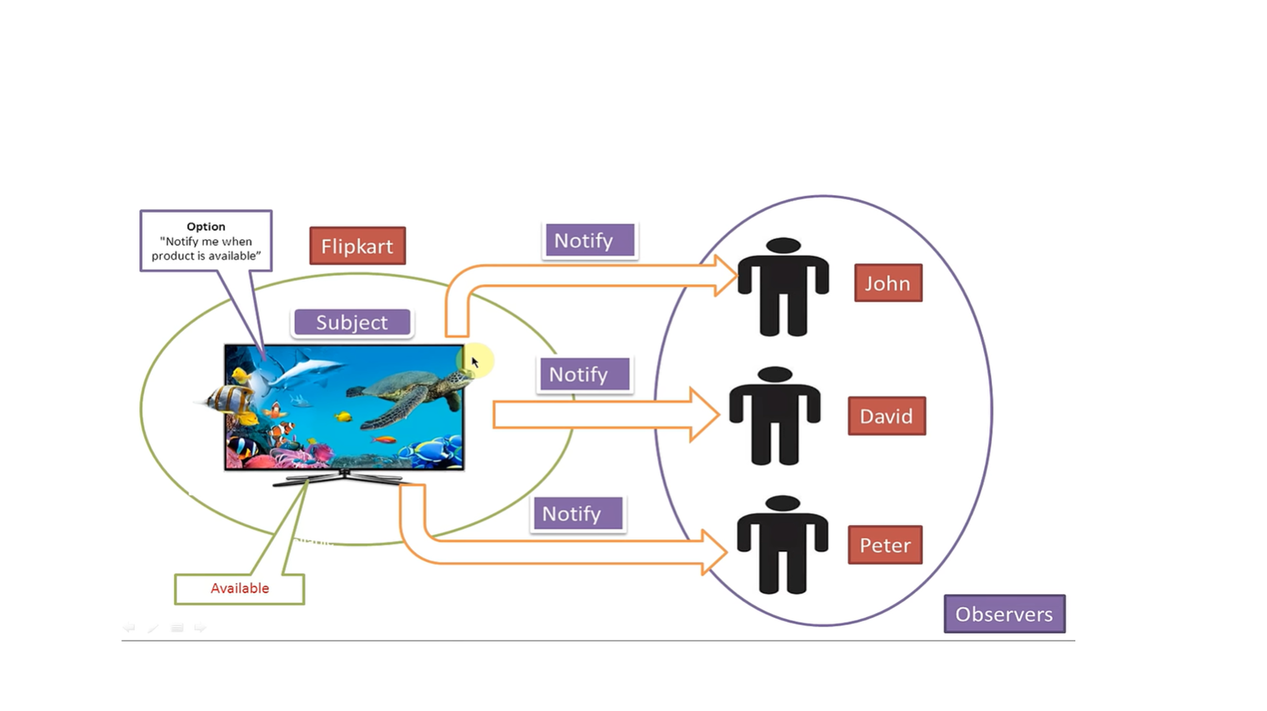

Slide 7
Key Concepts
Subject: Maintains a list of observers and notifies them of changes.
Observer: Defines an interface for receiving updates.
ConcreteSubject: Stores the state of interest and notifies observers on state changes.
ConcreteObserver: Implements the Observer interface and responds to updates.

Slide 8
Scenario Example: Weather Station
A WeatherStation (subject) broadcasts temperature updates. Several displays (observers) like a mobile app, LED panel, or website widget subscribe to receive updates.

Slide 9
When to Use
When changes in one object require updates in others.
When an object should notify other objects without knowing who they are.

Slide 10
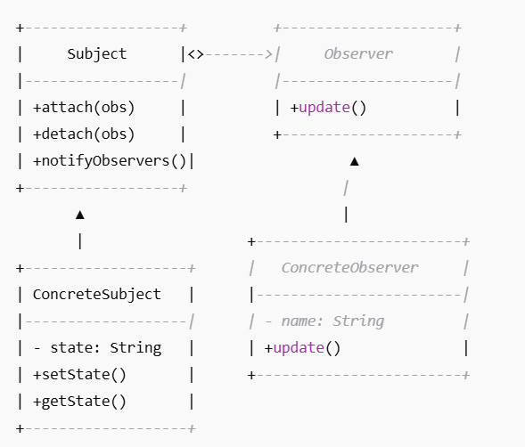

Slide 12
Java Implementation – Interfaces
// Observer Interface
interface Observer {
void update(String message);
}
// Subject Interface
interface Subject {
void attach(Observer o);
void detach(Observer o);
void notifyObservers();
}

Slide 13
Java Implementation – Concrete Classes
// Concrete Subject
class NewsAgency implements Subject {
private List<Observer> observers = new ArrayList<>();
private String news;
public void attach(Observer o) {
observers.add(o);
}
public void detach(Observer o) {
observers.remove(o);
}
public void setNews(String news) {
this.news = news;
notifyObservers();
}
public void notifyObservers() {
for (Observer o : observers) {
o.update(news);
}
}
}

Slide 14
// Concrete Observer
class Subscriber implements Observer {
private String name;
public Subscriber(String name) {
this.name = name;
}
public void update(String news) {
System.out.println(name + " received update: " + news);
}
}

Slide 15
Java Implementation – Demo

Slide 16
public class ObserverPatternDemo {
public static void main(String[] args) {
NewsAgency agency = new NewsAgency();
Subscriber s1 = new Subscriber("Alice");
Subscriber s2 = new Subscriber("Bob");
agency.attach(s1);
agency.attach(s2);
agency.setNews("Observer Pattern Launched!");
agency.setNews("More Updates Available!");
}
}

Slide 17
Output:
Alice received update: Observer Pattern Launched!
Bob received update: Observer Pattern Launched!
Alice received update: More Updates Available!
Bob received update: More Updates Available!

Slide 18
Real-World Applications
GUI Frameworks: Event listeners in Java Swing.
Messaging Systems: Publish-subscribe models.
Distributed Systems: Real-time data feeds.​

Slide 19
Benefits
Loose Coupling: Subjects and observers can vary independently.
Dynamic Relationships: Observers can be added or removed at runtime.
Broadcast Communication: Efficiently notify multiple observers.

Slide 20
Scenario:
Task: Implement a weather monitoring system where multiple displays (observers) receive updates from a weather station (subject) when temperature changes.​
Steps:
Define Observer and Subject interfaces.
Implement WeatherStation as the concrete subject.
Implement CurrentConditionsDisplay and StatisticsDisplay as concrete observers.
Simulate temperature changes and observe updates.​

Slide 21
Weather Monitoring System
Context:
A weather station gathers data such as temperature, humidity, and pressure. Different display elements (like current conditions, statistics, and forecast) need to update automatically when the weather changes.
Problem:
How can the system ensure that all display elements reflect the latest weather data without tightly coupling them to the WeatherStation?
Solution using Observer Pattern:
Use the Observer Design Pattern. The WeatherStation is the Subject, and all display elements are Observers. When weather data changes, the WeatherStation notifies all observers automatically.

Slide 22
Flow:
CurrentConditionsDisplay and ForecastDisplay register themselves with WeatherStation.
WeatherStation gets new sensor data.
It calls notifyObservers().
Each registered display element’s update() method is called automatically.

Slide 23
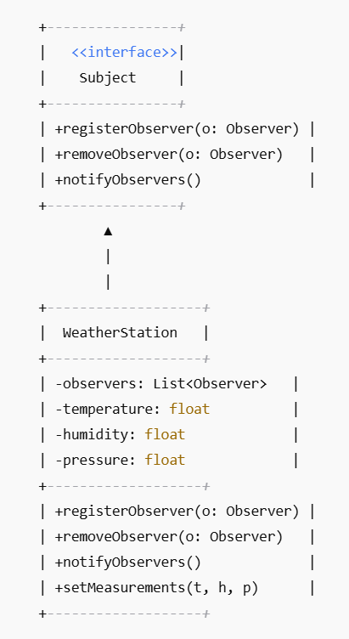
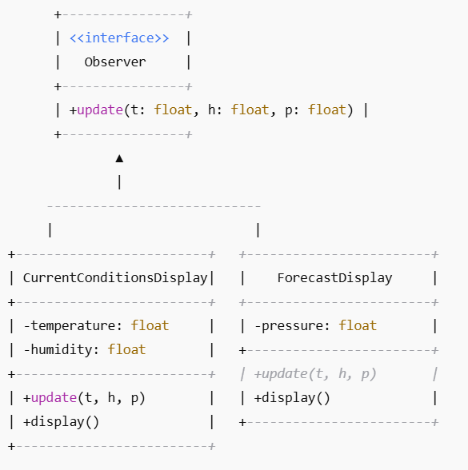

Slide 24
. Subject (WeatherData)
This is the core class that holds the data and notifies observers of any changes.
Methods:
registerObserver(Observer o)
Adds an observer to the list.
removeObserver(Observer o)
Removes an observer from the list.
notifyObservers()
Updates all registered observers when the state changes.
measurementsChanged()
Called whenever new weather data is available. It triggers notifyObservers().
getTemperature(), getHumidity(), getPressure()
Accessor methods to get current weather data.

Slide 25
2. Observer (Interface)
Defines the contract for all observers who want to be notified of changes in the Subject.
Method:
update(float temp, float humidity, float pressure)
Called by the subject when weather data changes.

Slide 26
DisplayElement (Interface)
Used to display the data on screen or console.
Method:
display()
Called to show the current state of the observer.

Slide 27
4. CurrentConditionsDisplay (Concrete Observer)
This is a concrete observer that implements Observer and DisplayElement.
Fields:
temperature, humidity
Stores the data it receives from the subject.
subject
Keeps a reference to the WeatherData object to register/unregister itself.
Methods:
update(temp, humidity, pressure)
Stores new values and calls display().
display()
Prints or shows the current conditions.

Slide 28
Flow Summary:
WeatherData (Subject) stores weather information.
CurrentConditionsDisplay (Observer) registers with WeatherData.
When measurementsChanged() is called, WeatherData invokes notifyObservers().
All registered observers get updated via the update() method.
Observers then display the updated info using display().

Slide 29
//Observer Interface
public interface Observer {
void update(float temperature, float humidity, float pressure);
}

Slide 30
//Subject Interface
public interface Subject {
void registerObserver(Observer o);
void removeObserver(Observer o);
void notifyObservers();
}

Slide 31
//WeatherStation (Concrete Subject)
import java.util.*;
public class WeatherStation implements Subject {
private List<Observer> observers;
private float temperature;
private float humidity;
private float pressure;
public WeatherStation() {
observers = new ArrayList<>();
}
public void registerObserver(Observer o) {
observers.add(o);
}
public void removeObserver(Observer o) {
observers.remove(o);
}

Slide 32
public void notifyObservers() {
for (Observer observer : observers) {
observer.update(temperature, humidity, pressure);
}
}
public void setMeasurements(float temperature, float humidity, float pressure) {
this.temperature = temperature;
this.humidity = humidity;
this.pressure = pressure;
notifyObservers();
}
}

Slide 33
//CurrentConditionsDisplay (Concrete Observer)
public class CurrentConditionsDisplay implements Observer {
private float temperature;
private float humidity;
public void update(float temperature, float humidity, float pressure) {
this.temperature = temperature;
this.humidity = humidity;
display();
}
public void display() {
System.out.println("Current conditions: " + temperature + "°C and " + humidity + "% humidity");
}
}

Slide 34
//ForecastDisplay (Concrete Observer)
public class ForecastDisplay implements Observer {
private float pressure;
public void update(float temperature, float humidity, float pressure) {
this.pressure = pressure;
display();
}
public void display() {
System.out.println("Forecast: Pressure is " + pressure + " hPa");
}
}

Slide 35
//Main
public class WeatherApp {
public static void main(String[] args) {
WeatherStation weatherStation = new WeatherStation();
CurrentConditionsDisplay currentDisplay = new CurrentConditionsDisplay();
ForecastDisplay forecastDisplay = new ForecastDisplay();
weatherStation.registerObserver(currentDisplay);
weatherStation.registerObserver(forecastDisplay);
// Simulating new weather data
weatherStation.setMeasurements(25.5f, 65.0f, 1013.0f);
weatherStation.setMeasurements(27.0f, 70.0f, 1012.5f);
}
}

Slide 36
Summary
The Observer Pattern is essential for implementing distributed event-handling systems.
It promotes a clean separation between the subject and its observers.
Ideal for scenarios requiring dynamic relationships between objects

Slide 37
Template Design Pattern

Slide 38
The Template Method Pattern defines the skeleton of an algorithm in a method, deferring some steps to subclasses.
It allows subclasses to redefine certain steps of the algorithm without changing its structure

Slide 39
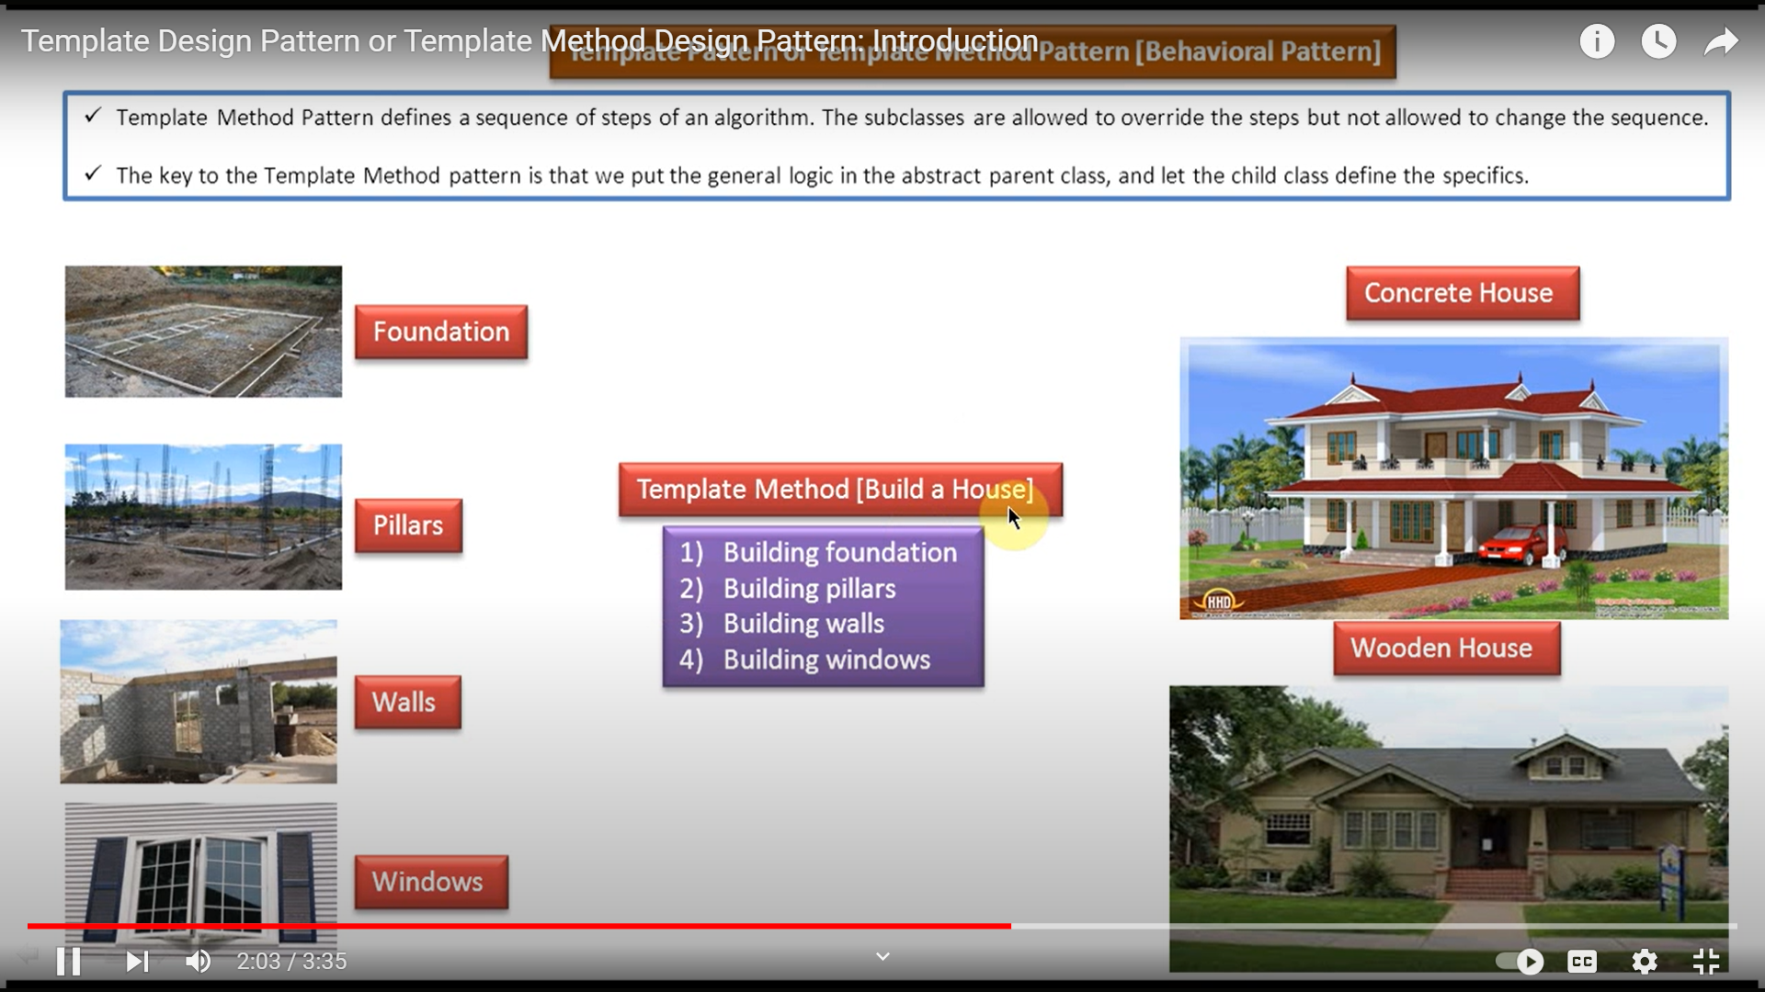

Slide 40
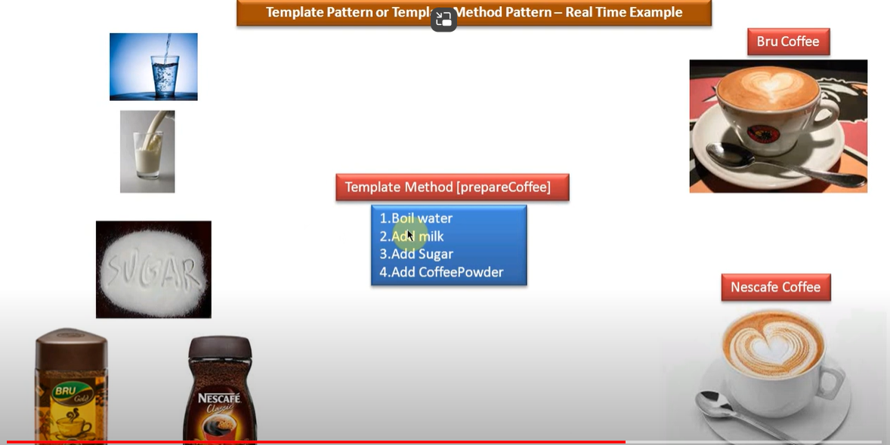
Template Method Design Pattern: Real-Time Example with Coffee Making

Slide 41
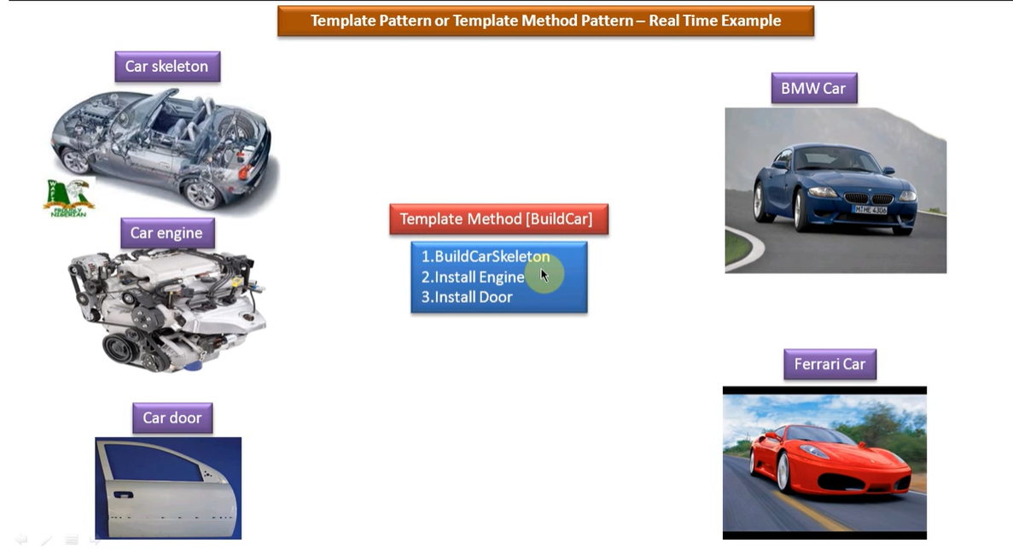
Template Method Design Pattern: Real Time Example of Building a Car

Slide 42
Benefits
Promotes code reuse by factoring out common code in a base class
Inversion of control: Subclasses decide the specifics without altering the algorithm
Ensures consistency in how subclasses implement certain steps

Slide 43
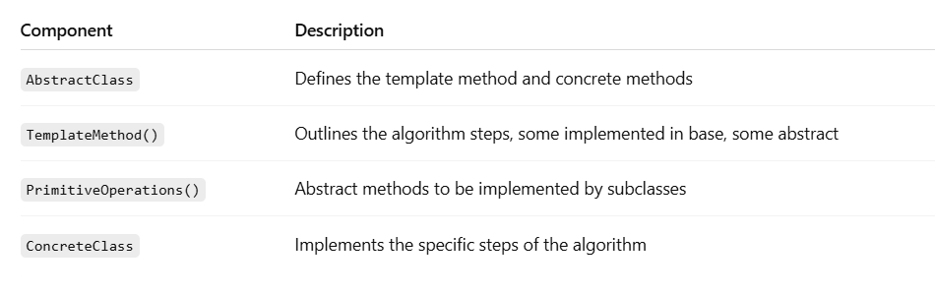

Slide 44
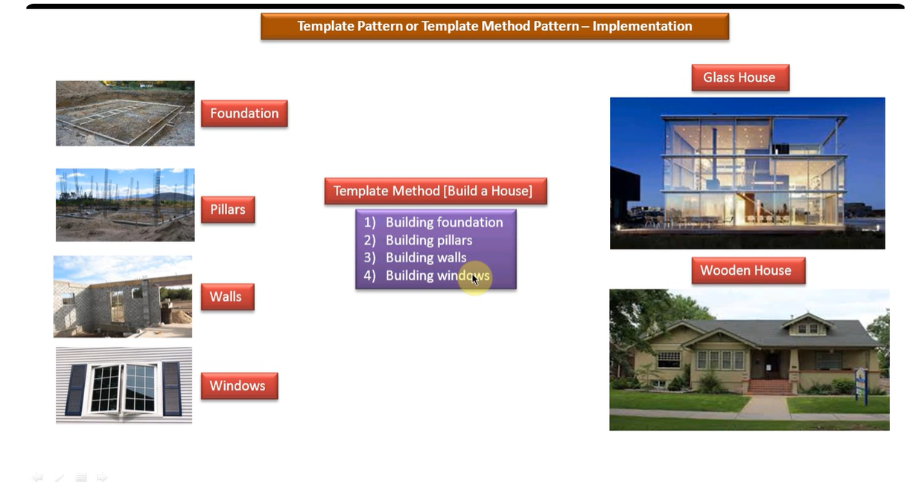
Template Design Pattern or Template Method Design Pattern Implementation: Building a House

Slide 45
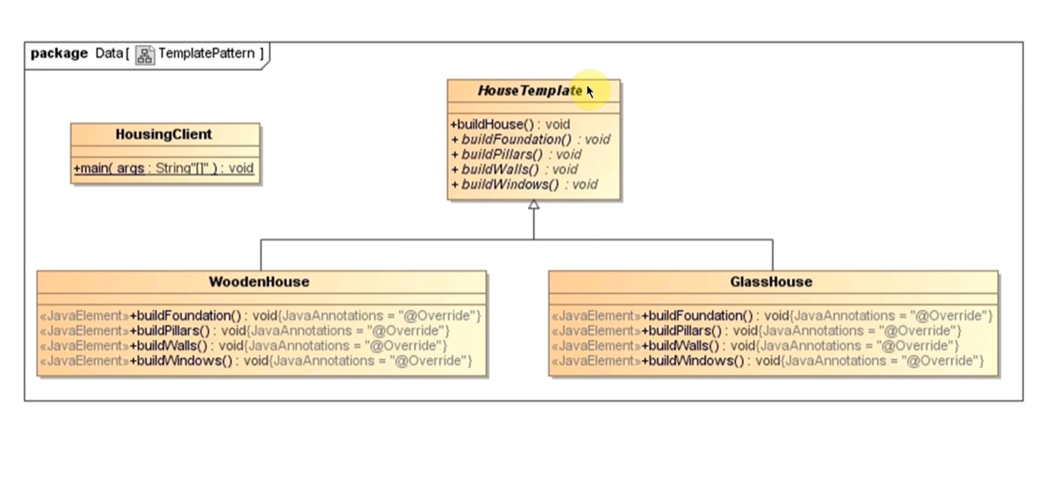

Slide 46
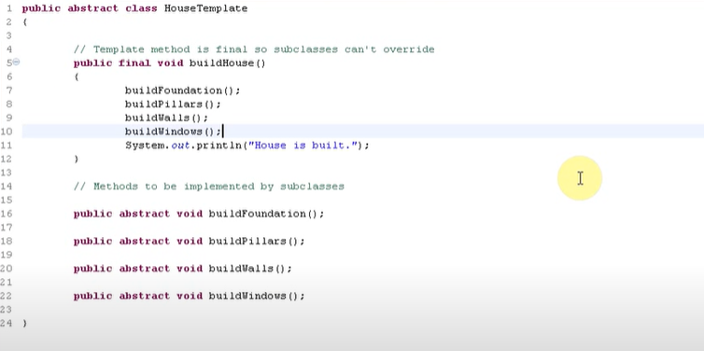

Slide 47
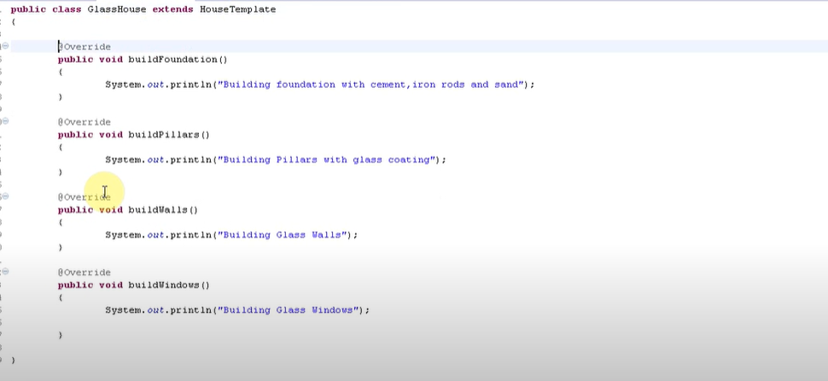

Slide 48
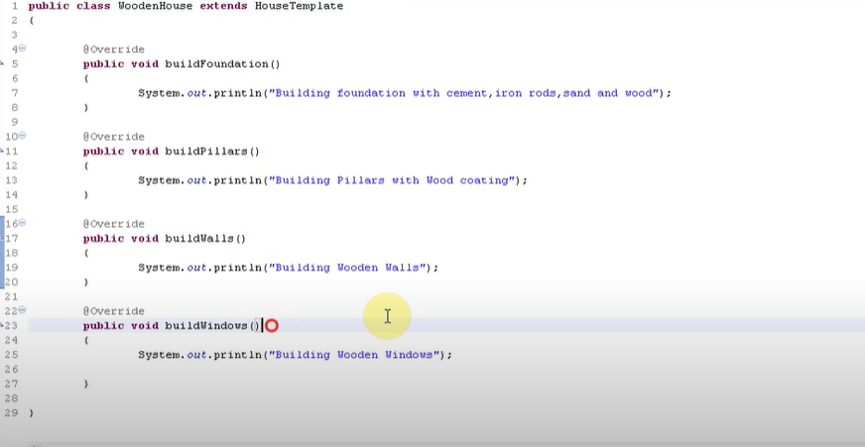

Slide 49
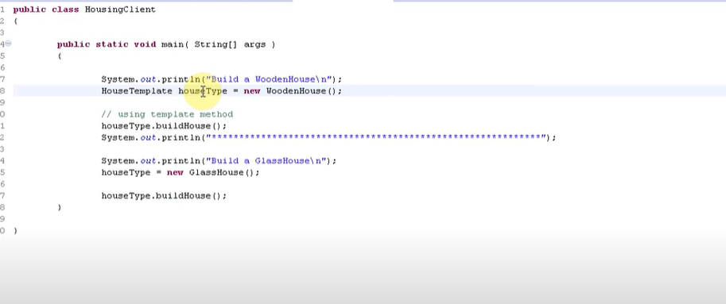

Slide 50
Scenario: Document Generation System
Goal
You want to build a system that generates reports in different formats — e.g., PDF, HTML. The structure of the document is the same:
Header
Content
Footer
The format of these parts varies based on the type of report.

Slide 51
Abstract Class: DocumentGenerator
abstract class DocumentGenerator {
// Template Method
public final void generateDocument() {
writeHeader();
writeContent();
writeFooter();
}
abstract void writeHeader();
abstract void writeContent();
abstract void writeFooter();
}

Slide 52
Concrete Class: PDFDocument
class PDFDocument extends DocumentGenerator {
void writeHeader() {
System.out.println("PDF Header: Company Logo");
}
void writeContent() {
System.out.println("PDF Content: Financial Summary in tables");
}
void writeFooter() {
System.out.println("PDF Footer: Confidential - Page 1");
}
}

Slide 53
Concrete Class: HTMLDocument
class HTMLDocument extends DocumentGenerator {
void writeHeader() {
System.out.println("<h1>HTML Report Title</h1>");
}
void writeContent() {
System.out.println("<p>HTML content with graphs and tables</p>");
}
void writeFooter() {
System.out.println("<footer>Generated by System</footer>");
}
}

Slide 54
Demo Program
public class TemplateMethodExample {
public static void main(String[] args) {
DocumentGenerator pdf = new PDFDocument();
DocumentGenerator html = new HTMLDocument();
System.out.println("Generating PDF Document:");
pdf.generateDocument();
System.out.println("\nGenerating HTML Document:");
html.generateDocument();
}
}

Slide 55
Output
Generating PDF Document:
PDF Header: Company Logo
PDF Content: Financial Summary in tables
PDF Footer: Confidential - Page 1
Generating HTML Document:
<h1>HTML Report Title</h1>
<p>HTML content with graphs and tables</p>
<footer>Generated by System</footer>

